Slide 1
Chest X-ray Pathology Detection with CNN
Xiao-hong Deng, Gerry Meixiong, Chenxu Wen, Elisa Yao

Slide 2
Overview
Background
Related Work
Dataset
Approach
Implementation
Results
Next Steps

Slide 3
Background
Chest X-rays are an accessible and effective method for screening and diagnosis of many diseases.
Still many challenges for radiologists in confirming diagnoses from x-rays.
Several groups have approached the problem of computer-aided diagnosis of disease through x-rays.

Slide 4
Related Work
Several large, publicly-accessible datasets of chest x-rays have been released to assist experimentation in this field.
ChestX-ray 14
CheXPert
A number of disease classification models trained on these datasets with a machine learning approach have been published.
Li et al. perform disease identification and localization via CNNs and location annotations.
Rajpurkar et al. develops CheXNet, a 121-layer Dense Convolutional Network (DenseNet).
Gundel et al. propose location-aware Dense Networks (DNetLoc).

Slide 5
Dataset Overview
CheXpert dataset.
Comprised of 224,316 chest radiographs from 65,240 patients with 14 distinct labels.
Collected from Stanford Hospital between October 2002 and July 2017.
Data was processed with an automatic labeler
An observation is marked as uncertain (u), negative (0), or certain (1).
Example labels:
Lung Lesion
Pneumonia
Pleural Effusion

Slide 6
Approach
Reproduce the CheXNet model described by Rajpurkar et al. with more training data:
Original paper used ChestX-ray 14 (~100K images).
We use the CheXPert dataset.
Split CheXPert dataset based on the three image view types.
Frontal AP
Frontal PA
Lateral
Utilize PyTorch, transfer-learning, and Keras.
Trained on machine with specs: i5-3470 CPU, 16GB RAM, GTX 1070 GPU with 8GB on-board memory

Slide 7
Implementation 1
Use smaller CheXPert to train a DenseNet-121 model via PyTorch. This dataset only requires ~10GB of space, and the model could be run on a local machine for ease of development.
Model trained from scratch and loaded with pre-trained weights on the ImageNet dataset.
Preprocessing: images are randomly horizontally flipped, resized to 224x224, and standardized.
Trained for 5 epochs where each epoch consisted of 6981 batches of 32 images each.

Slide 8
Implementation 2: Transfer Learning
The model from the previous implementation step was built on.
Layers with weights trained on the ImageNet dataset were frozen.
The last classification layer was initialized randomly and trained.
Preprocessing: resized images to 224x224, shift all pixel values to [0, 1].
Implemented in Keras and trained for 3 epochs. As only the last layer is trainable, the bottleneck was the image loading to GPU.

Slide 9
Implementation 3
Continued training based on model from the second implementation.
In theory, this can avoid the flaw from the first approach where some layers have fine-tuned weights and others have random weights.
The random weights propagate gradients that are too large and increase the time for the model to converge.
Preprocessing: Same steps as Implementation 2.

Slide 10
Results
Pathology | Trained from Scratch (Impl 1) | Transfer Learning (Impl 2) | Trained from TF (Impl 3) | CheXPert
Atelectasis | 0.834 | 0.720 | 0.788 | 0.858
Cardiomegaly | 0.790 | 0.673 | 0.831 | 0.832
Consolidation | 0.868 | 0.658 | 0.857 | 0.899
Edema | 0.906 | 0.779 | 0.911 | 0.941
Pleural Effusion | 0.920 | 0.724 | 0.933 | 0.934

Slide 11
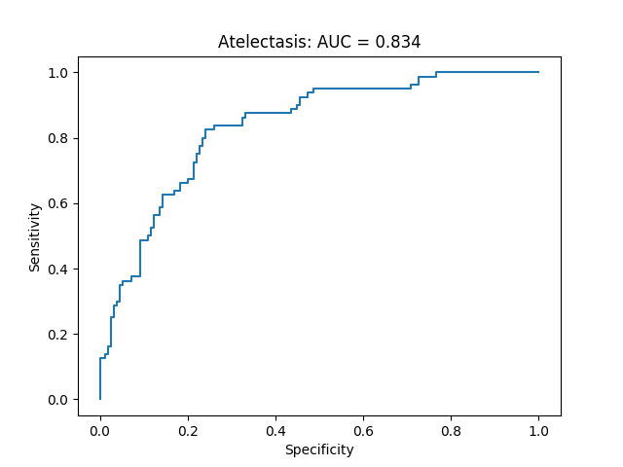
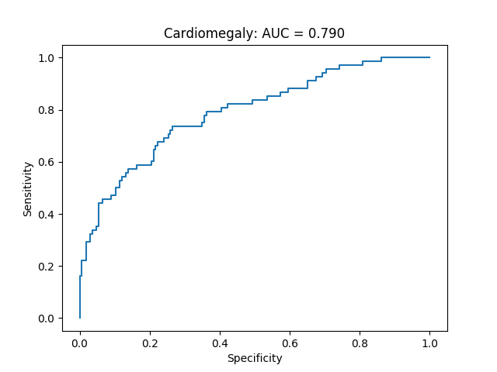
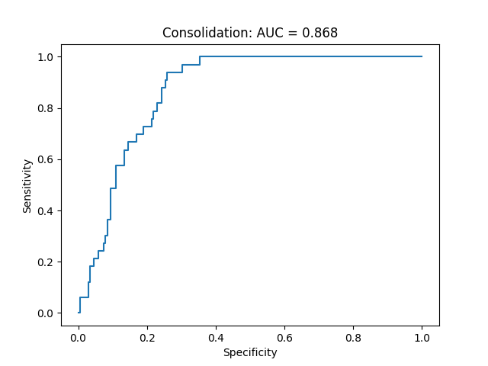
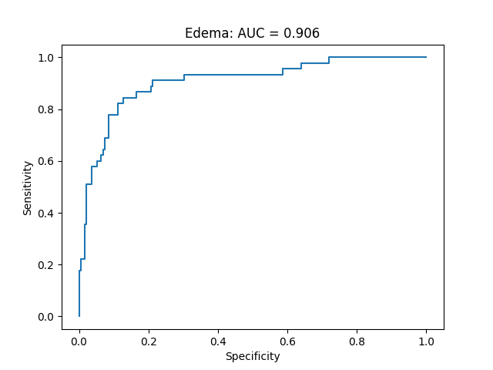
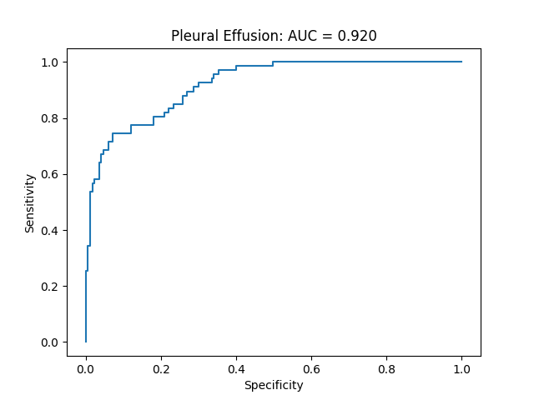
Results (cont.)

Slide 12
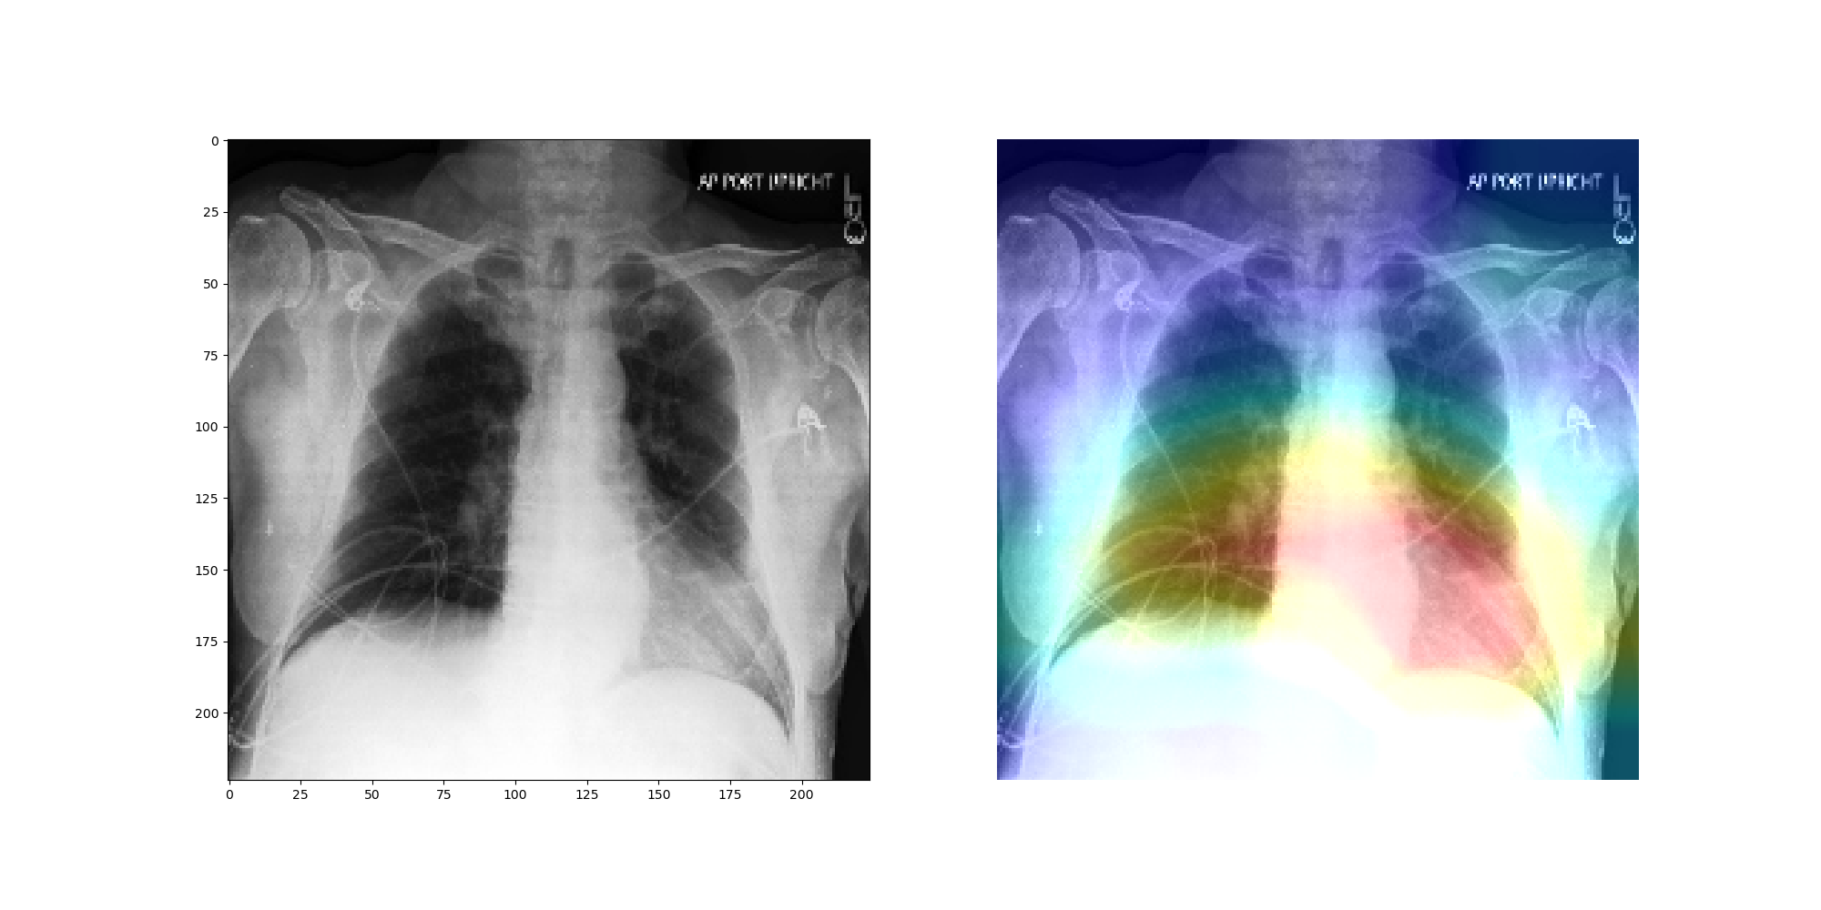
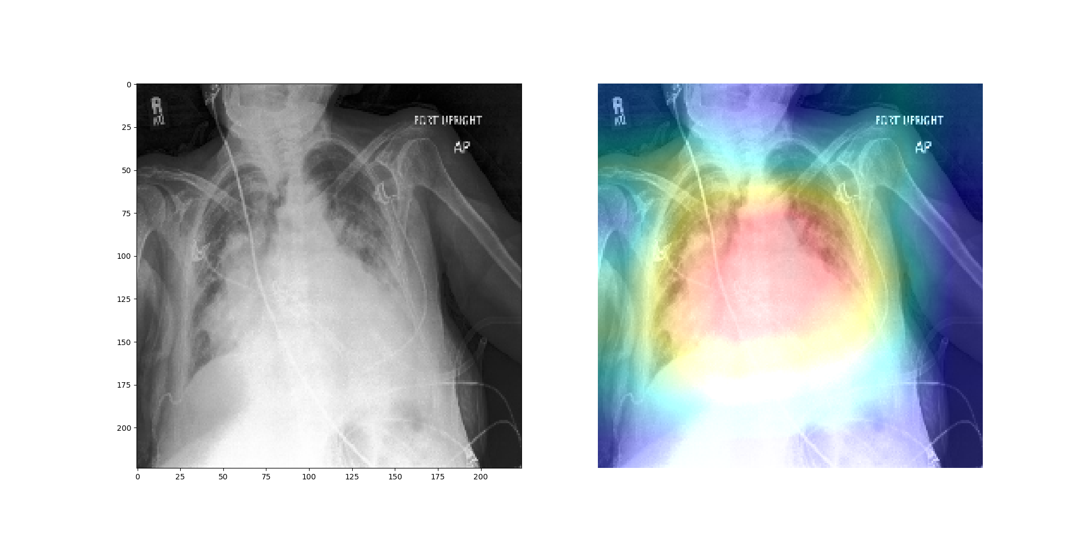
Results (cont.)
The transfer learning based approach was substantially worse.
The other two approaches had similar performance on average but did not hold up to the results in the CheXPert paper.
Applied class activation mapping technique described by Irvia et al.

Slide 13
Conclusion and Next Steps
We implemented the CheXNet model and trained it on the CheXPert dataset.
The overall performance is almost on par with the ones proposed in the original paper.
A few improvements we were considering but constrained by time:
Ensemble
Aggressive data augmentation
Mixed label encoding

